Slide 1
Advanced Software Engineering
Module II

Slide 2
Syllabus
Programming Style Guides and Coding Standards; Literate programming and Software documentation; Documentation generators, Javadoc, phpDocumentor.
Version control systems basic concepts; Concept of Distributed version control system and Git; Setting up Git; Core operations in Git version control system using command line interface (CLI): Clone a repository; View history; Modifying files; Branching; Push changes, Clone operation, add, commit, log, diff commands, conflict resolution. Pushing changes to the master; Using Git in IDEs and UI based tools.
Software Quality: Understanding and ensuring requirements specification quality, design quality, quality in software development, conformance quality.

Slide 3
Introduction
A programming style guide is an opinionated guide of programming conventions, style, and best practices for a team or project.
Some teams call it their coding guidelines, coding standards, or coding conventions.
While these each have their own meaning in programming, they generally refer to the same thing.
A team following a style guide helps everyone write code in a consistent way, and consistent code is easier to read and faster to update.
Consistent code is easier to read and understand making it faster to add new features.

Slide 4
Programming Guide Style
Programming Style Guide is a written document, containing a set of rules or guidelines used when writing source code for a computer program (it might be an Android app, desktop software or even a video game).
A particular programming style may be different from coding conventions, or even designed around a specific language or even program. For example, what is considered a good practice in C, may not be really appropriate for BASIC.
A product code (or code of different programs created by a particular company) should look like it was written by a single person, even if it was written by hundreds.
Style guide should talk about indentation, variable naming, vertical alignment, even comments.
Programming style, also known as code style, is a set of rules or guidelines used when writing the source code for a computer program.

Slide 5
Continues..
Following a particular programming style will help programmers read and understand source code conforming to the style, and help to avoid introducing errors.
The programming style used in a particular program may be derived from the coding conventions of a company or other computing organization, as well as the preferences of the author of the code. Programming styles are often designed for a specific programming language (or language family).
The purpose of the source code that we create is to communicate our intentions to the other software developers who will follow us to maintain, improve, and otherwise work with what we’ve left behind for them.
Programming styles commonly deal with the visual appearance of source code, with the goal of readability. Software has long been available that formats source code automatically, leaving coders to concentrate on naming, logic, and higher techniques.

Slide 6
Code appearance
Indentation - Indentation styles assist in identifying control flow and blocks of code. In some programming languages, indentation is used to delimit logical blocks of code; correct indentation in these cases is more than a matter of style. In other languages, indentation and white space do not affect function, although logical and consistent indentation makes code more readable.
Vertical alignment - to align similar elements vertically
Spaces - In those situations where some white space is required, the grammars of most free-format languages are unconcerned with the amount that appears. Style related to white space is commonly used to enhance readability.
Tabs - The use of tabs to create white space presents particular issues when not enough care is taken because the location of the tabulation point can be different depending on the tools being used and even the preferences of the user.

Slide 7
Coding standards
Coding standards are a set of guidelines, best practices, programming styles and conventions that developers adhere to when writing source code for a project.
A coding standard gives a uniform appearance to the codes written by different engineers.
It improves readability, and maintainability of the code and it reduces complexity also.
It helps in code reuse and helps to detect error easily.
It promotes sound programming practices and increases efficiency of the programmers.

Slide 8
Some of the coding standards
Limited use of globals
Standard headers for different modules
Naming conventions for local variables, global variables, constants and functions
Indentation
Error return values and exception handling conventions
Avoid using a coding style that is too difficult to understand
Avoid using an identifier for multiple purposes
Code should be well documented
Length of functions should not be very large
Try not to use GOTO statement

Slide 9
Continues..
Widely accepted style guides that you should consider to start with:
Google’s Style Guides
JavaScript Standard Style
GitHub’s Ruby Style Guide
Python Foundation’s Style Guide
Airbnb’s JavaScript Style Guide
Angular’s Style Guide

Slide 10
Continues..
Implementing one of these generally accepted style guides is a good start to helping your team write code consistently.
Make your style guide easy to reference.
Style guide acts as a basic code blueprint for your team during all parts of the software development lifecycle.
To keep relevant, it should be often discussed. Such as during a developers onboarding, when writing code, when writing tests, and during code review.

Slide 11
Literate Programming
It is a methodology that combines a programming language with a documentation language, thereby making programs more robust, more portable, more easily maintained, and arguably more fun to write than programs that are written only in a high-level language.
The main idea is to treat a program as a piece of literature, addressed to human beings rather than to a computer.
The program is also viewed as a hypertext document, rather like the World Wide Web.

Slide 12
Software documentation
Software documentation is a part of any software.
Appropriate details and description need to be in the documented to achieve the following goals.
Resolve issue encountered by the developer during the development process.
Help end-user to understand the product.
Assist customers and the support team to find the information.

Slide 13
Continues..
For a programmer reliable documentation is always a must.
Documentation increases the collective knowledge of everyone that you work with.
Successful documentation will make information easily accessible, provide a limited number of user entry points, help new users learn quickly, simplify the product and help cut support costs.
The main goal of effective documentation is to ensure that developers and stakeholders are headed in the same direction to accomplish the objectives of the project.

Slide 14
Continues..
There are so many types of documentation.
All software documentation can be divided into two main categories:
Product documentation
Process documentation
The main difference between process and product documentation is that the first one record the process of development and the second one describes the product that is being developed.

Slide 15
Product Documentation
Product documentation describes the product that is being developed and provides instructions on how to perform various tasks with it.
Product documentation further divided into
System documentation
Documents that describe the system itself and its parts. It includes requirements documents, design decisions, architecture descriptions, program source code, and help guides.
User documentation
They are manuals that are mainly prepared for end-users of the product and system administrators. It also includes tutorials, user guides, troubleshooting manuals, installation, and reference manuals.

Slide 16
Process documentation
It represents all documents produced during development and maintenance.
Examples of process documentation are project plans, test schedules, reports, standards, meeting notes, or even business correspondence.

Slide 17
Javadoc
JavaDoc tool is a document generator tool in Java programming language for generating standard documentation in HTML format.
It generates API documentation.
Before using JavaDoc tool, you must include JavaDoc comments /**………………..*/ providing information about classes, methods, and constructors, etc.
For creating a good and understandable document API for any java file you must write better comments for every class, method, constructor.

Slide 18
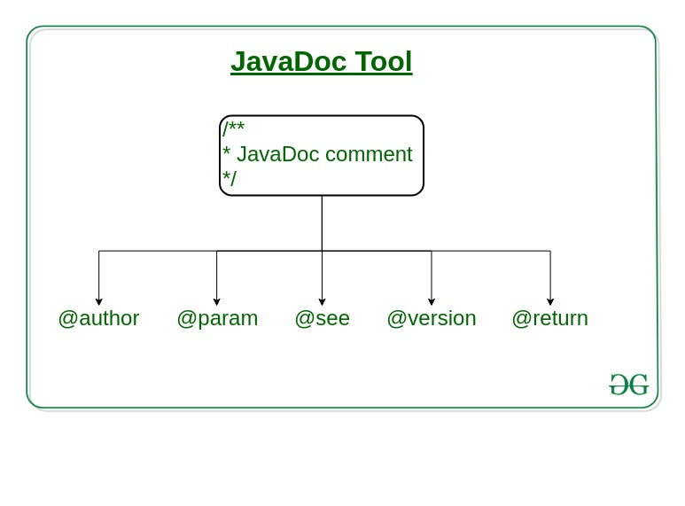
Continues..

Slide 19
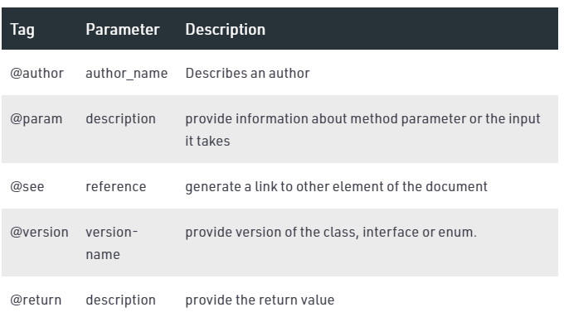
Continues..

Slide 20
Continues..
The JavaDoc comments is different from the normal comments because of the extra asterisk at the beginning of the comment. It may contain the HTML tags as well.
// Single-Line Comment
/*
Multiple-Line comment
*/
/**
JavaDoc comment
*/

Slide 22
Continues..
By writing a number of comments, it does not affect the performance of the Java program as all the comments are removed at compile time.

Slide 23
Generation of JavaDoc
To create a JavaDoc you do not need to compile the java file. To create the Java documentation API, you need to write Javadoc followed by file name.
javadoc file_name or javadoc package_name
After successful execution of the above command, a number of HTML files will be created, open the file named index to see all the information about classes.

Slide 24
phpDocumentor
phpDocumentor is an application that is capable of analyzing PHP source code and DocBlock comments to generate a complete set of API Documentation.
phpDocumentor v3 (Stable)
v3 is the latest stable release.
The easiest way to run phpDocumentor is by running the following command:
$ phpdoc run -d <SOURCE_DIRECTORY> -t <TARGET_DIRECTORY>

Slide 25
Version control
Version control is a system that records changes to a file or set of files over time so that you can recall specific versions later.
It is a software that helps software developers to work together and maintain a complete history of their work.
It allows you
To revert selected files back to a previous state.
To revert the entire project back to a previous state.
To compare changes over time.
To see who last modified something that might be causing a problem.
To find who introduced an issue and when, and more.

Slide 26
Functions of Version Control System
Allows developers to work simultaneously.
Does not allow overwriting each other’s changes.
Maintains a history of every version.

Slide 27
Types of Version Control System
Local Version Control System
Centralized version control system (CVCS).
Distributed/Decentralized version control system (DVCS).

Slide 28
Local Version Control System
A time-stamped directory used to copy files.

Slide 29
Centralized Version Control Systems(CVCS)
These systems have a single server that contains all the versioned files, and a number of clients that check out files from that central place.

Slide 30
Distributed Version Control Systems (DVCS)
In a DVCS, clients don’t just check out the latest snapshot of the files; rather, they fully mirror the repository, including its full history.
Thus, if any server dies, and these systems were collaborating via that server, any of the client repositories can be copied back up to the server to restore it.
Every clone is really a full backup of all the data.
Users can collaborate with different groups of people in different ways simultaneously within the same project.
Example
Git, Mercurial, Bazaar or Darcs

Slide 31
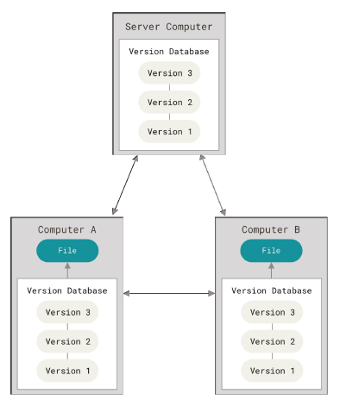
Continues..

Slide 32
GIT
Git consider its data like a series of snapshots of a miniature file system.
Every time when committing, or saving the state of project, Git takes a picture of what all files look like at that moment and stores a reference to that snapshot.
If files have not changed, Git doesn’t store the file again, just a link to the previous identical file it has already stored.
Git thinks about its data more like a stream of snapshots.

Slide 33
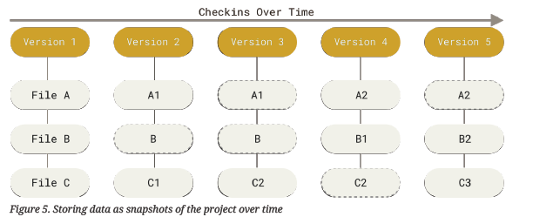
Storing data as snapshots of the project over time

Slide 34
Continues..
Everything in Git is checksummed before it is stored and is then referred to by that checksum.
It’s impossible to change the contents of any file or directory without Git knowing about it.
This functionality is built into Git at the lowest levels and is integral to its philosophy.
Information is not lost in transit or get file corruption without Git being able to detect it.

Slide 35

Continues..
The mechanism that Git uses for this checksumming is called a SHA-1 hash.
This is a 40-character string composed of hexadecimal characters (0–9 and a–f) and calculated based on the contents of a file or directory structure in Git.
Git stores everything in its database not by file name but by the hash value of its contents.
A SHA-1 hash looks something like this:

Slide 36
Continues..
When an action is done in Git, it only add data to the Git database. It is hard to get the system to do anything that is not undoable or to make it erase data in any way.
But after committing a snapshot into Git, it is very difficult to lose, especially if database is pushed to another repository.
Git has three main states that your files can reside in:
Modified means that you have changed the file but have not committed it to your database yet.
Staged means that you have marked a modified file in its current version to go into your next commit snapshot.
Committed means that the data is safely stored in your local database.

Slide 37
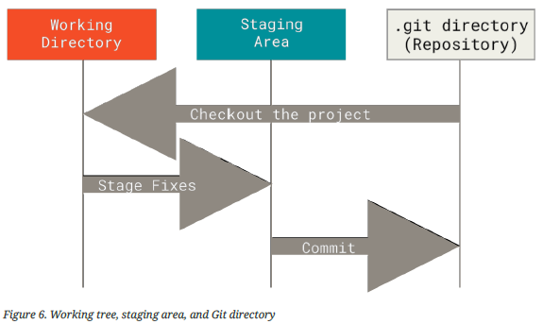
Continues..
This leads us to the three main sections of a Git project: the working tree, the staging area, and the Git directory.

Slide 38
Continues..
The working tree is a single checkout of one version of the project. These files are pulled out of the compressed database in the Git directory and placed on disk for you to use or modify.
The staging area is a file, generally contained in your Git directory, that stores information about what will go into your next commit. Its technical name in Git parlance is the “index”, but the phrase “staging area” works just as well.
The Git directory is where Git stores the metadata and object database for your project. This is the most important part of Git, and it is what is copied when you clone a repository from another computer.
If a particular version of a file is in the Git directory, it’s considered committed.
If it has been modified and was added to the staging area, it is staged.
If it was changed since it was checked out but has not been staged, it is modified.

Slide 39
SETTING UP GIT
Git has a tool called git config that get and set configuration variables that control all aspects of how Git looks and operates.
These variables can be stored in three different places:
[path]/etc/gitconfig file
~/.gitconfig or ~/.config/git/config file
config file in the Git directory

Slide 40
Continues..
[path]/etc/gitconfig file:
It contains values applied to every user on the system and all their repositories.
If the option –system is passed to git config, it reads and writes from this file specifically.
Because this is a system configuration file, it needs administrative or superuser privilege to make changes to it.\
~/.gitconfig or ~/.config/git/config file:
Values specific personally to the user.
Git can read and write to this file specifically by passing the --global option, and this affects all of the repositories you work with on your system.
config file in the Git directory
It is specific to that single repository.
Git can be forced to read from and write to this file with the --local option, but that is in fact the default.
You need to be located somewhere in a Git repository for this option to work properly.

Slide 41
Continues..
In Windows,Git looks for the .gitconfig file in the $HOME directory (C:\Users\$USER).
There is also a system-level config file at C:\Documents and Settings\All Users\Application Data\Git\config on Windows XP, and in
C:\ProgramData\Git\config on Windows Vista and newer.
This config file can only be changed by git config -f <file> as an admin.

Slide 42

Continues..

Slide 43

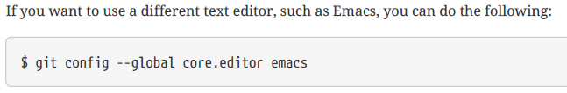
Continues..
After installing Git, set your user name and email address.
Configure the default text editor that will be used when Git needs you to type in a message. If not configured, Git uses your system’s default editor.

Slide 44

Continues..
By default Git will create a branch called master when you create a new repository with git init.
To set main as the default branch name do:

Slide 45
Command Line
Command line is the only place you can run all Git commands.
By knowing how to run the command-line version, we can probably figure out how to run the GUI version.

Slide 46
Cloning a Git Repository
Git repository can be obtained in one of two ways:
You can take a local directory that is currently not under version control, and turn it into a Git repository,
or
You can clone an existing Git repository from elsewhere. In either case, you end up with a Git repository on your local machine, ready for work.
Every version of every file for the history of the project is pulled down by default when you run git clone.
In fact, if your server disk gets corrupted, you can often use nearly any of the clones on any client to set the server back to the state it was in when it was cloned.

Slide 47
Continues..
You clone a repository with git clone <url>.
For example, if you want to clone the Git linkable library called libgit2, you can do so like this:
$ git clonehttps://github.com/libgit2/libgit2
That creates a directory named libgit2, initializes a .git directory inside it, pulls down all the data for that repository, and checks out a working copy of the latest version.
If you go into the new libgit2 directory that was just created, you’ll see the project files in there, ready to be worked on or used.

Slide 48
Continues..
If you want to clone the repository into a directory named something other than libgit2, you can specify the new directory name as an additional argument:
$ git clone https://github.com/libgit2/libgit2 mylibgit

Slide 49
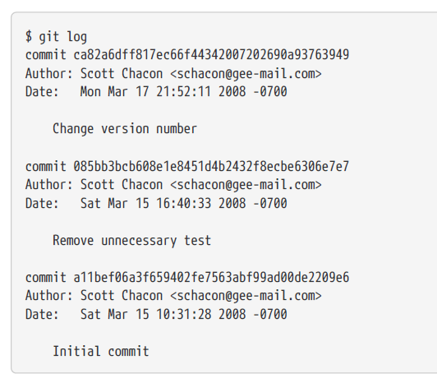
VIEWING THE COMMIT HISTORY
After creating several commits, or if a repository is cloned with an existing commit history and to look back to see what has happened. The most basic and powerful tool to do this is the git log command.
When you run git log in this project, you should get output that looks something like this:

Slide 50
Continues..
By default, with no arguments, git log lists the commits made in that repository in reverse chronological order; that is, the most recent commits show up first.
git log lists each commit with its SHA-1 checksum, the author’s name and email, the date written, and the commit message.
Options -p or --patch shows the difference (the patch output)introduced in each commit.
The number of log entries displayed can be limited such as using -2 to show only the last two entries.

Slide 51
Continues..
$ git log -p -2
commit ca82a6dff817ec66f44342007202690a93763949
Author: Scott Chacon <schacon@gee-mail.com>
Date: Mon Mar 17 21:52:11 2008 -0700
Change version number
To see some abbreviated stats for each commit, you can use the --stat option
The --stat option prints below each commit entry a list of modified files, how many files were changed, and how many lines in those files were added and removed. It also puts a summary of the information at the end.

Slide 52
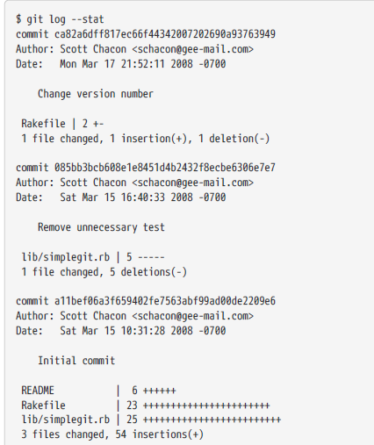
Continues..

Slide 53
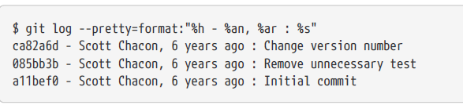
Continues..
The option --pretty changes the log output to formats other than the default. The oneline value for this option prints each commit on a single line, which is useful if you’re looking at a lot of commits.
The short, full, and fuller values show the output in roughly the same format but with less or more information, respectively.
The option format allows you to specify your own log output format. This is useful when you’re generating output for machine parsing because it specify the format explicitly, you know it won’t change with updates to Git:

Slide 54
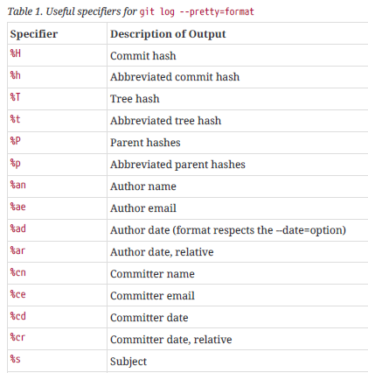
Continues..

Slide 55
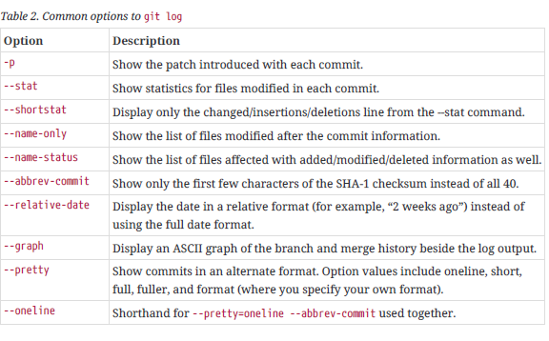
Continues..

Slide 56

Continues..
The time-limiting options such as --since and --until are very useful.
For example, this command gets the list of commits made in the last two weeks:
The -S option takes a string and shows only those commits that changed the number of occurrences of that string.
$ git log -S function_name
The last really useful option to pass to git log as a filter is a path. If you specify a directory or file name, you can limit the log output to commits that introduced a change to those files.
$ git log -- path/to/file

Slide 57
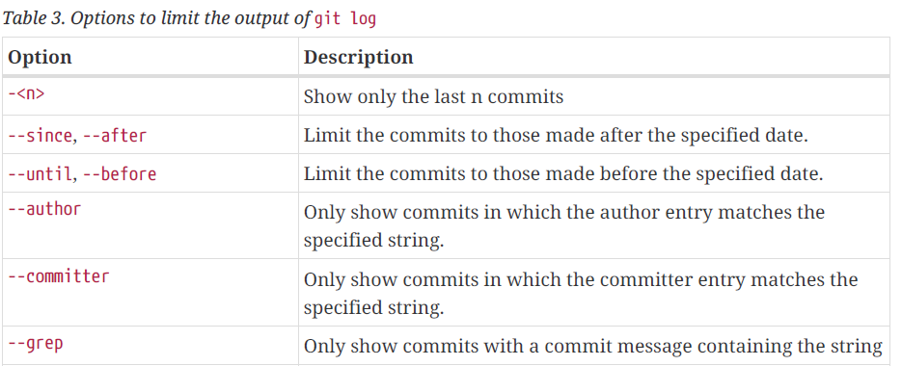
Continues..

Slide 58
Git Branching
Branching means you diverge from the main line of development and continue to do work without messing with that main line.
Git branches are incredibly lightweight, making branching operations nearly instantaneous, and switching back and forth between branches is fast.
Git encourages workflows that branch and merge often, even multiple times in a day.
When you make a commit, Git stores a commit object that contains a pointer to the snapshot of the content you staged.
This object also contains the author’s name and email address, the message that you typed, and pointers to the commit or commits that directly came before this commit : zero parents for the initial commit, one parent for a normal commit, and multiple parents for a commit that results from a merge of two or more branches.

Slide 59
Continues..
Let’s assume that you have a directory containing three files, and you stage them all and commit.
Staging the files computes a checksum for each one, stores that version of the file in the Git repository (Git refers to them as blobs), and adds that checksum to the staging area:
$ git add README test.rb LICENSE
$ git commit -m 'Initial commit'

Slide 60
Continues..
Git repository now contains five objects:
three blobs (each representing the contents of one of the three files)
one tree that lists the contents of the directory and specifies which file names are stored as which blobs
one commit with the pointer to that root tree and all the commit metadata.

Slide 61
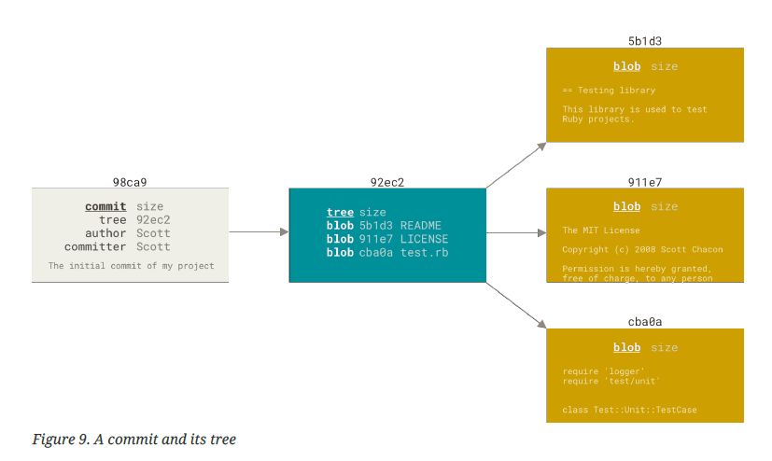
Continues..

Slide 62
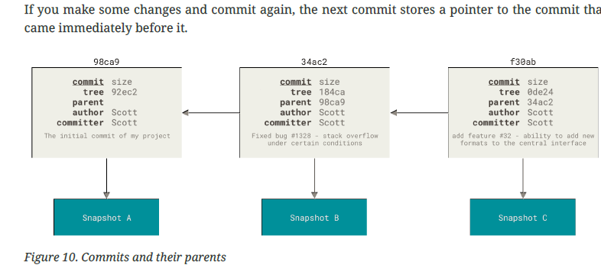
Continues..

Slide 63
Continues..
A branch in Git is simply a lightweight movable pointer to one of these commits.
The default branch name in Git is master.
As you start making commits, you’re given a master branch that points to the last commit you made.
Every time you commit, the master branch pointer moves forward automatically.

Slide 64
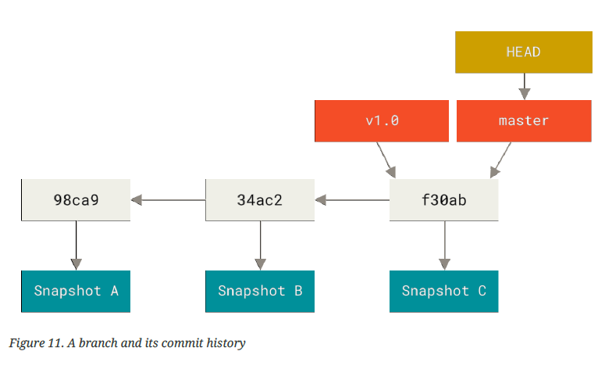
Continues..

Slide 65
Creating a New Branch
To create a new branch called testing.
This is done with the git branch command:
$ git branch testing

Slide 66
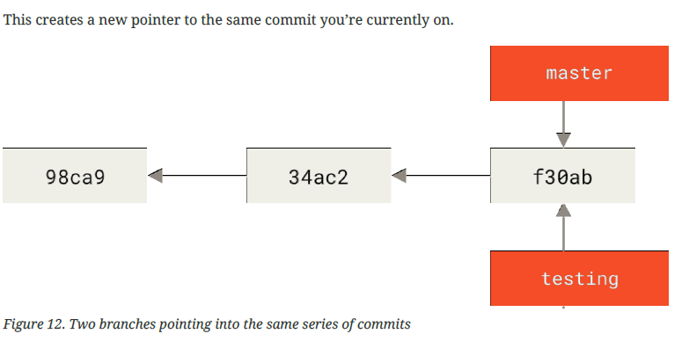
Continues..

Slide 67
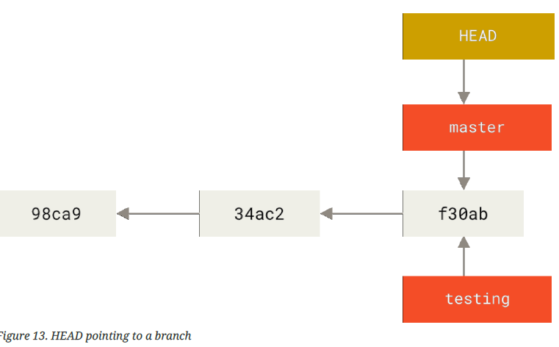
Continues..

Slide 68
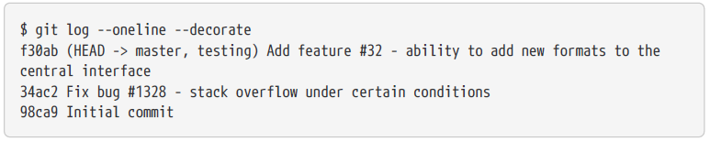
Continues..
It keeps a special pointer called HEAD.
In Git, this is a pointer to the local branch you’re currently on. Its still on master.
The git branch command only created a new branch,it didn’t switch to that branch.
git log command that shows you where the branch pointers are pointing is called --decorate.

Slide 69
Switching Branches
To switch to an existing branch, you run the git checkout command.
Let’s switch to the new testing branch:
$ git checkout testing
This moves HEAD to point to the testing branch.

Slide 70
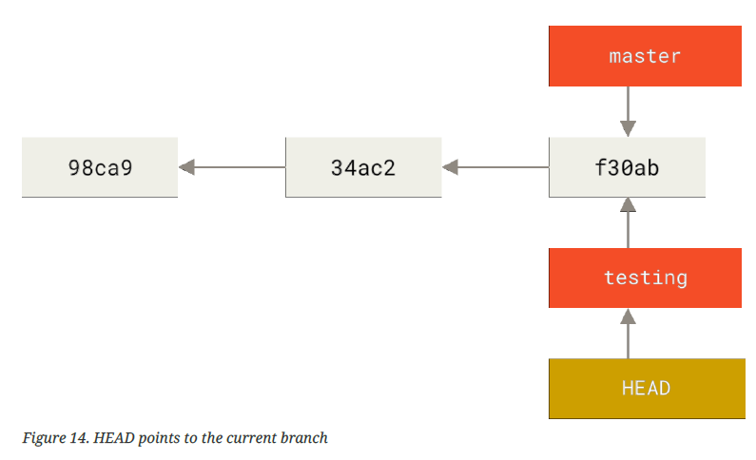
Continues..

Slide 71
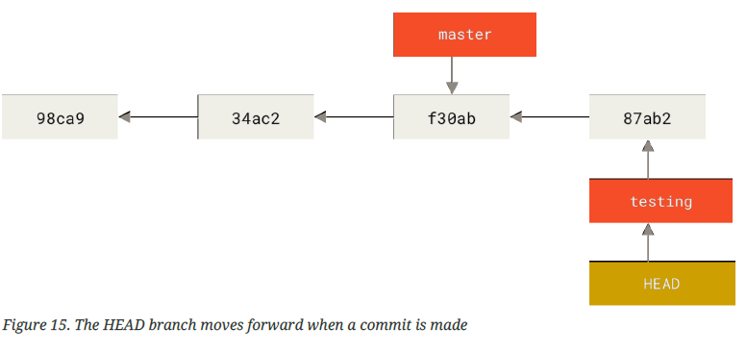
Continues..
$ vim test.rb $ git commit -a -m 'made a change'

Slide 72
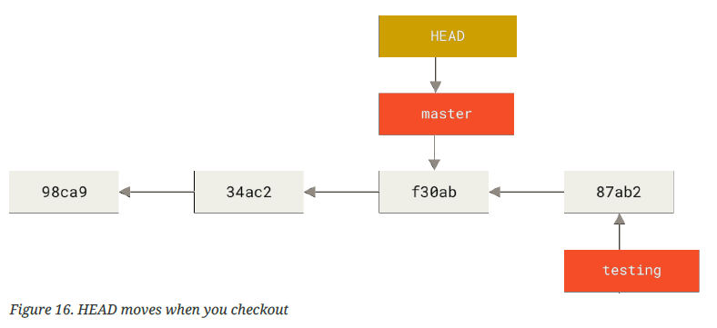
Continues..
Testing branch has moved forward, but master branch still points to the commit you were on when you ran git checkout to switch branches. Let’s switch back to the master branch:
$ git checkout master

Slide 73
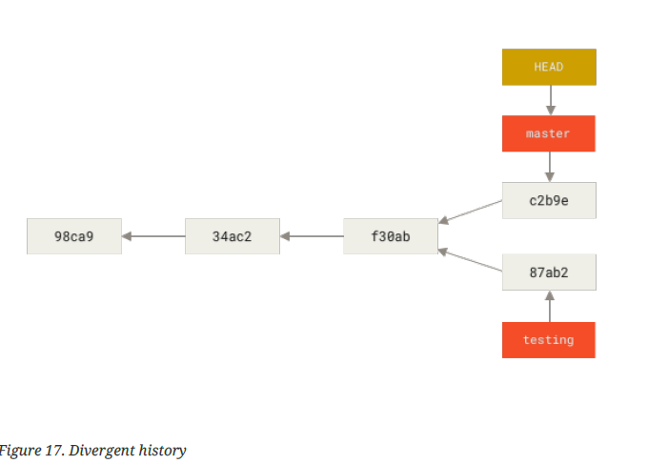
Continues..
$ vim test.rb
$ git commit -a -m 'made other changes'

Slide 74
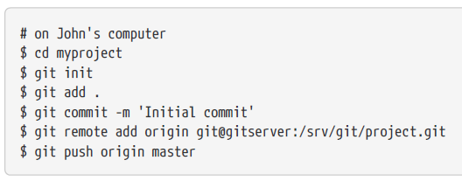
Push Changes
When you do actions in Git, nearly all of them only add data to the Git database.
As with any VCS, you can lose or mess up changes you haven’t committed yet, but after you commit a snapshot into Git, it is very difficult to lose, especially if you regularly push your database to another repository.

Slide 75
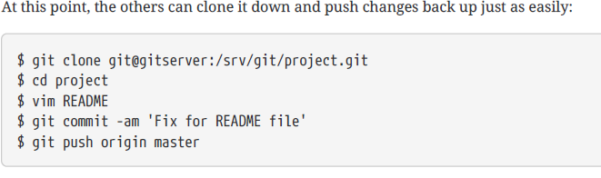
Continues..

Slide 76
Adding Remote Repositories
The git add command adds content from the working directory into the staging area (or “index”)for the next commit.
When the git commit command is run, by default it only looks at this staging area, so git add is used to craft what exactly you would like your next commit snapshot to look like.

Slide 77
Continues..
git add
The git add command adds content from the working directory into the staging area (or “index”)for the next commit.
When the git commit command is run, by default it only looks at this staging area, so git add is used to craft what exactly you would like your next commit snapshot to look like.
git diff
The git diff command is used when you want to see differences between any two trees.
This could be the difference between your working environment and your staging area,between your staging area and your last commit, or between two commits.

Slide 78
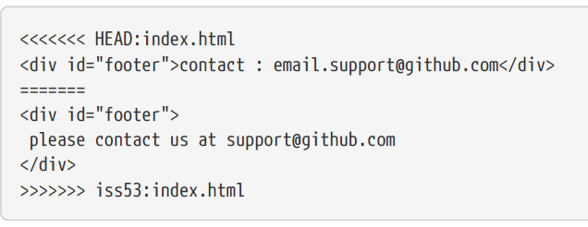
Conflict-resolution
Git adds standardconflict-resolution markers to the files that have conflicts, so you can open them manually andresolve those conflicts.
Your file contains a section that looks something like this:

Slide 79
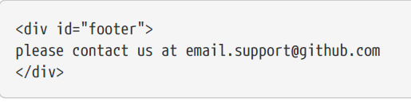
Continues..
This means the version in HEAD is the top part of that block (everything above the =======),while the version in your iss53 branch looks like everything in the bottom part.
In order to resolve the conflict, you have to either choose one side or the other or merge the contents yourself.
For instance, you might resolve this conflict by replacing the entire block with this:

Slide 80
Quality
Text Book :
Mastering Software Quality Assurance
by
Murali Chemuturi

Slide 81
Quality
The International Organization for Standardization (ISO 9000, second edition, 2000) defines quality as the degree to which a set of inherent characteristics fulfills requirements.
This definition contains three key terms: requirements, characteristics, and degree.
Requirements can be stated by a customer in a made-to-order scenario or by product specifications in a commercial off-the-shelf product scenario.
Characteristics refers to the capability of the deliverable or, in other words, the robustness (fitness) of the product.
The word degree implies that quality is a continuum, beginning with zero and moving toward, perhaps, infinity.

Slide 82
Continues..
Quality is an attribute of a product or service provided to consumers that conforms into or exceeds the best of the available specifications for that product or service.
It includes making those specifications available to the end user of the product or service.
The specifications that form the basis of the product or service provided may have been defined by a government body, an industry association, or a standards body.
Where such a definition is not available, the provider may define the specifications.

Slide 83
Continues..
Quality has four dimensions:
Specification quality
Design quality
Development (software construction) quality
Conformance quality
Specifications are the starting point in the journey of providing a product or service, followed by design and then development.
Conformance quality is ensuring how well that quality is built into the deliverable at every stage.

Slide 84
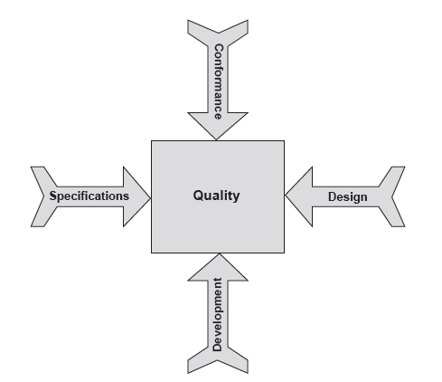
Continues..

Slide 85
Specification Quality
Specification quality refers to how well the specifications are defined for the product or service being provided.
Specifications have no predecessor activity, and all other activities succeed specifications.
Thus, if the specifications are weak, design will be weak, resulting in the development and manufacture of an incorrect product, and the effort spent on ensuring that quality is built in will have been wasted.

Slide 86
Continues..
Specifications normally should include the following six aspects:
Functionality aspects : Specify what functions are to be achieved by the product or service.
Capacity aspects : Specify the load the product can carry(such as 250 passengers on a plane or 100 concurrent users for a Web application).
Intended use aspects : Specify the need or needs the product or service satisfies.
Reliability aspects : Specify how long the product can be enjoyed before it needs maintenance.
Safety aspects : Specify the threshold levels for ensuring safety to persons and property from use of the product or service
Security aspects : Specify any threats for which the product or service needs to be prepared.

Slide 87
Ensuring Quality in Specification
In the software industry, specifications are referred to as user requirements.
The following are possible scenarios for obtaining user requirements:
A business analyst conducts a feasibility study, writes up a report, and draws up the user requirements. The analyst:
Meets with all the end users and notes their requirements and concerns.
Meets with the function heads and notes their requirements and concerns.
Meets with management personnel and notes their requirements and concerns.
Consolidates the requirements and presents them to select end users, function heads, and management personnel and receives their feedback, if any.
Implements the feedback and finalizes specifications.

Slide 88
Continues..
A ready set of user requirements is presented as part of a request for proposal.
A request for proposal points to a similar product and requests replication with client-specific customization.
Regardless of the scenario, once the specifications are ready, quality assurance steps in.
The role of quality assurance in this area is to ensure that the specifications are exhaustive and cover all areas including functionality, capacity, reliability, safety, security, intended use, etc.

Slide 89
Continues..
The tools for building quality into specifications are as follows:
Process documentation - Details the methodology for gathering, developing, analyzing, and finalizing the specifications.
Standards and guidelines, formats, and templates - Specify the minimum set of specifications that needs to be built in.
Checklists – Help analysts to ensure comprehensiveness of the specifications.

Slide 90
Design Quality
Design quality refers to how well the product or service to be delivered is designed.
The objectives for design are to fulfill the specifications defined for the product or service being provided.
Design determines the shape and strengths of the product or service.
Therefore, if the design is weak, the product or service will fail, even if the specifications are very well defined.

Slide 91
Continues..
Design can be split into two phases:
Conceptual design selects the approach to a solution from the multiple approaches available.
Engineering uses the approach selected and works out the details to realize the solution.
Conceptual design is the creative part of the process, and engineering is the details part.
In terms of software, conceptual design(High Level Design) refers to software architecture, navigation, number of tiers, approaches to flexibility, portability, maintainability, and so on. Engineering design(Low Level Design) refers to database design, program specifications, screen design, report design, etc.

Slide 92
Continues..
Software design normally contains the following elements
Functionality design
Software architecture
Navigation
Database design
Development platform
Deployment platform
User interface design
Report design
Security
Fault tolerance
Capacity
Reliability
Maintainability
Efficiency and concurrence
Coupling and cohesion
Program specifications
Test design

Slide 93
Continues..
It is normal to conduct a brainstorming session at the beginning of software design project, to select one optimum design alternative and to decide on the overall design aspects, Such as the number of tiers, technology platform, software coupling and cohesion, etc.
A brainstorming session helps designers arrive at the best possible solution for the project.

Slide 94
Continues..
The tools for building quality into design include the following:
Process documentation - Details the methodology for design alternatives to be considered, criteria for selecting the alternative for the project, and finalizing the conceptual design.
Standards and guidelines, formats, and templates - Specify the possible software architectures along with their attendant advantages and disadvantages and so on.
Checklists - Help designers to ensure that design is carried out comprehensively and appropriately.

Slide 95
Development(Software Construction) Quality
The following activities form part of developing software:
Create the database and table structures.
Develop dynamically linked libraries for common routines.
Develop screens.
Develop reports.
Develop unit test plans.
Develop associated process routines for all other aspects, such as security, efficiency, fault tolerance, etc.

Slide 96
Continues..
Good-quality construction is achieved by adhering to the coding guidelines of the programming language being used. Normally there is a separate coding guideline for every programming language used in an organization.
Coding guidelines contain naming conventions, code formatting that help developers write reliable and defect-free code.
Of course, it is very important to have qualified people trained in software development.
Construction follows software design, and it should always conform to the design document.

Slide 97
Continues..
Good-quality can also be achieved by adhering to the Organizational Standards.
Uncontrolled changes may affect the quality of the code.
So change management and configuration management may be applied.
There are two techniques to ensure that quality is built into a product:
Reviews(Walkthroughs)
Testing

Slide 98
Conformance Quality
It deals with how well an organization ensures that quality is built into a product through the previous three dimensions.
It is through quality work and ensure that all the defects in the product is uncovered.
Conformance quality examines how well quality control is carried out in the organization.
It can be achieved by
Audits
Quality Measurements
Metrices
Benchmarking

Slide 99
Continues..
It can be also ensured by Appling
Validation and Verification activity
Defect injection rate
Defect density rate
Etc.
Continues improvement.
Quality assurance.

